Slide 1
REDCap Support Ticket Management
Penn State University and Penn State College of Medicine

Slide 2
OLD System
Simple REDCap project to record minimal details
Required users to spell out details and areas they were seeking support
Email used to converse between support and user
Reassigning tickets/viewing history of how past issues are solved was impossible
Lack of data for reporting
Significant time invested in manually gathering data at end of year
Separate REDCap projects for account versus project support
Users often had to fill out multiple records only to find they had to put their request in somewhere else

Slide 3
New System requirements
Logging communications between user and support
Expand reporting capabilities
Metrics on support, determine success, areas for improvement
Integrate account and project support requests
Make it easier on the user
Expand request types to make assigning tickets more efficient
No longer need to read large text field to understand the request
Expand notifications to users and support
Avoid ‘lost’ tickets, intuitive/normal email alerts for users
Integrate feedback mechanism

Slide 4
WHY not use a REAL ticket management system?
Penn State/College of Medicine basically two separate entities
REDCap is shared system using shared accounts
Support team is not centralized; made up of members from multiple departments
Where would a separate system or additional code live? What happens if that department is no longer supporting REDCap?
Cost – full ticket management systems can be expensive

Slide 5
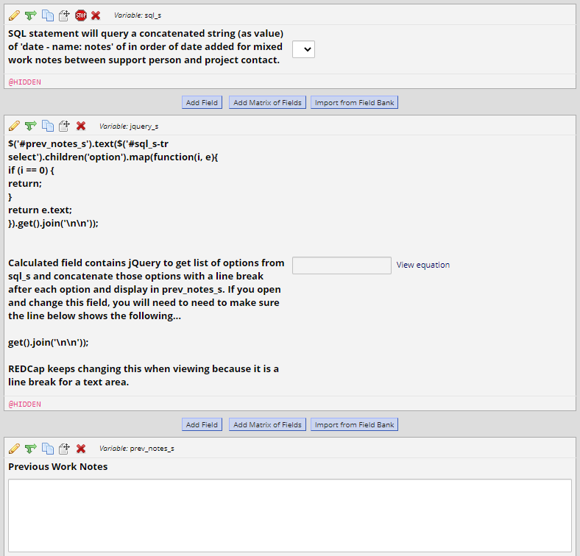
Logging comms between user and support
Limited options in REDCap available to record conversations
Need to keep data organized for later retrieval
Support team granted REDCap admin permissions which opened up SQL and JavaScript
Settled on SQL and jQuery (JavaScript) solution
SQL Field to concatenate and record user/support conversations
Calculated field, using jQuery, to split the SQL field into readable format

Slide 6
Expand Reporting Capabilities
Dashboards created to easily view
Total number of tickets received vs resolved
Where tickets are coming from (location and department)
Types of support requested
Tracking response time
Reduce need for manual gathering of data

Slide 7
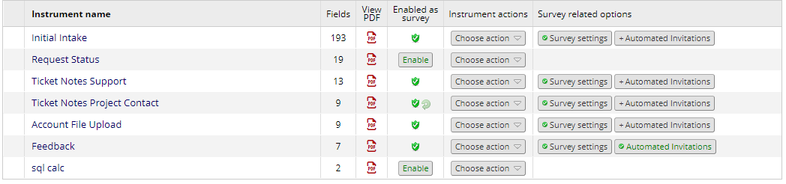
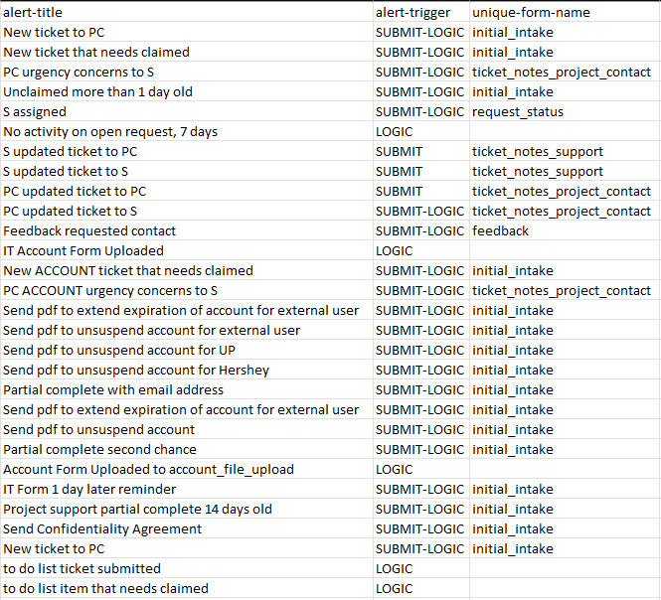
Instruments consist of
Initial Intake: survey to capture ticket details by user
Request Status: form for support to mark who claimed ticket, date when ticket is resolved, and more
Ticket Notes Support: survey to capture notes in ticket from support
Ticket Notes Project Contact: survey to capture notes in ticket from user
Account File Upload: survey to capture uploaded PDF for special account requests
Feedback: survey for users to provide support feedback on ticket resolution
Sql calc: used by reports and dashboards

Slide 8
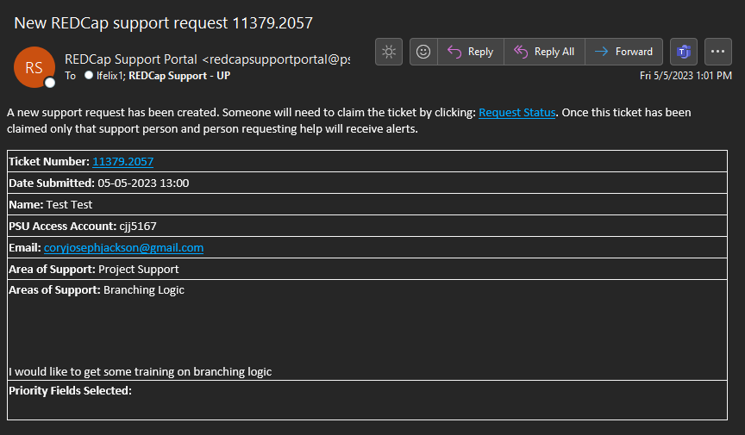
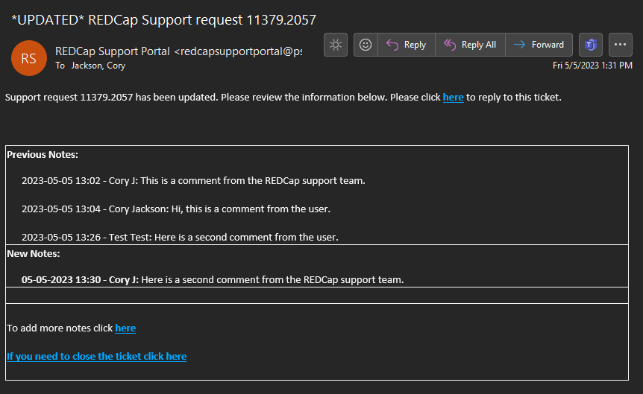
Example of generated emails.

Slide 9
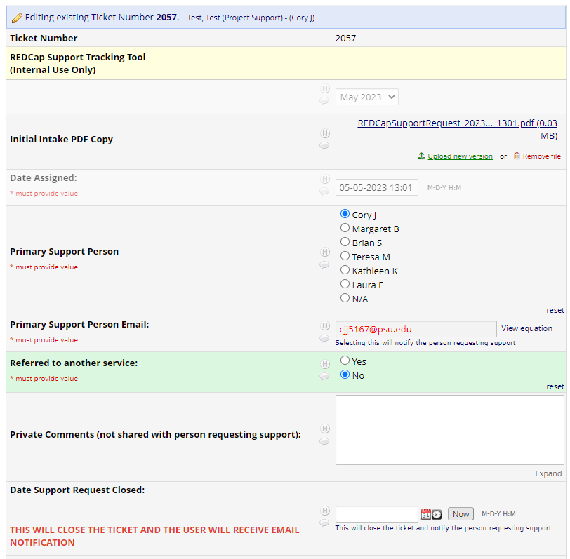

Slide 10
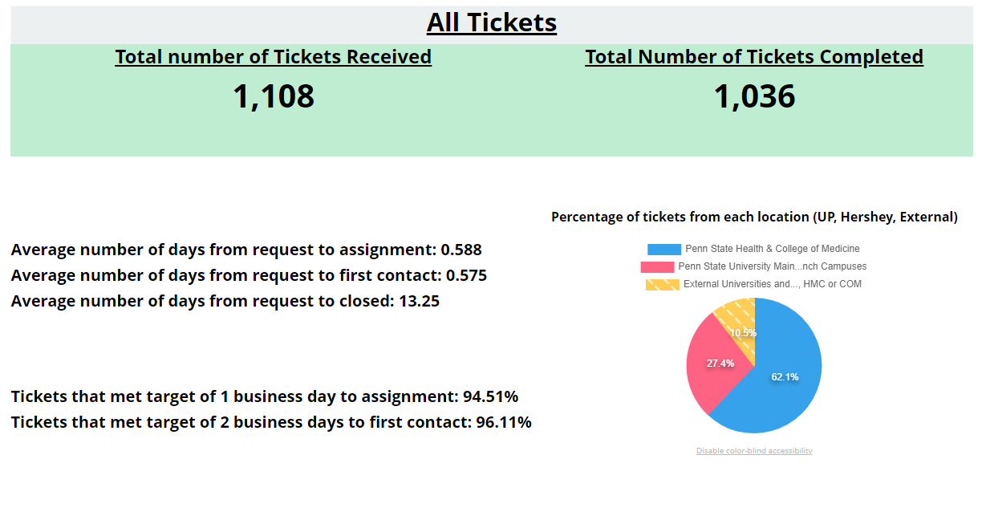
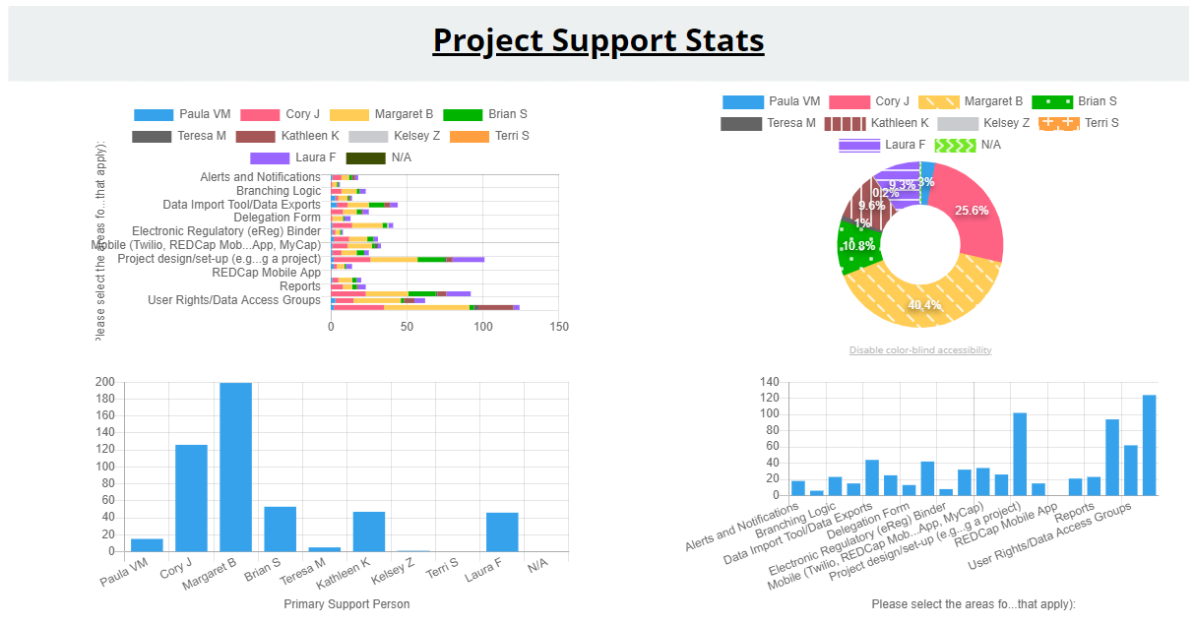

Slide 11

Exploring the project
Designer Overview
Intake through assignment
Support/User notes
Feedback
Alerts and Notifications
22 Alerts
Reporting
File Repository

